Slide 1


Online Event Planner
Welcome to the world of event planning made easy!

Slide 2
Our Team : The IT Crowd
Aaditi Jadhav
Jainil Raval
Jayvardhan Rathi
Mounika Boini
Ninad Sachania
Khushbu Nangliya
Sneha Zambare

Slide 3


Introduction to the Online Event Planner Application
Our Online Event Planner Application allows you to effortlessly plan and organize your events virtually, such as weddings, birthday parties, and other special occasions.

Slide 4
Features of the Application
Responsive
Secure
Scalable
Robust
Our application is designed to be fully responsive, ensuring a seamless user experience on any device, whether it's a desktop, tablet, or smartphone.
We prioritize the security of your data. Our robust security measures protect your information, ensuring a safe and reliable event planning experience.
Whether you're organizing an intimate gathering or a large-scale conference, our application scales effortlessly to meet the needs of events of any size.
Expect a powerful and feature-rich event planning platform. From customizable templates to comprehensive analytics, our application is built to deliver exceptional functionality.

Slide 5
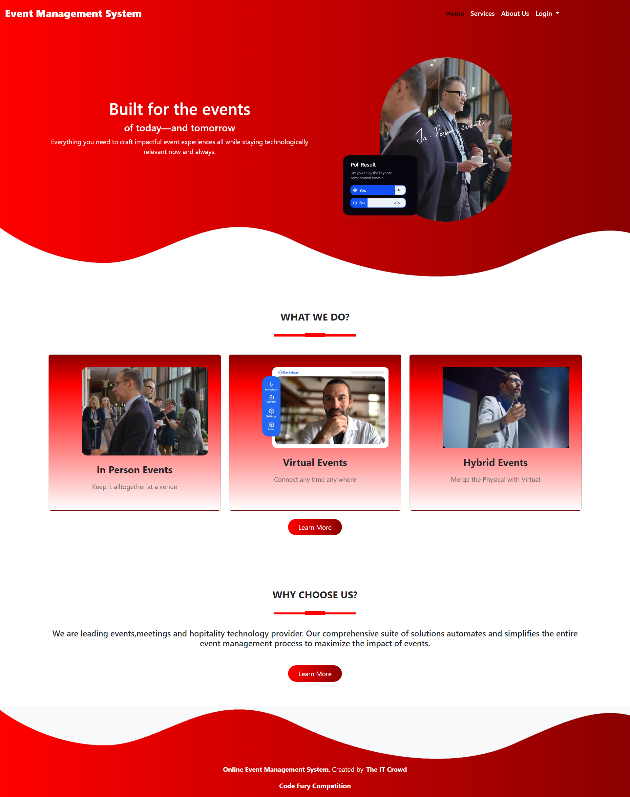
Home
UI Snapshots

Slide 6
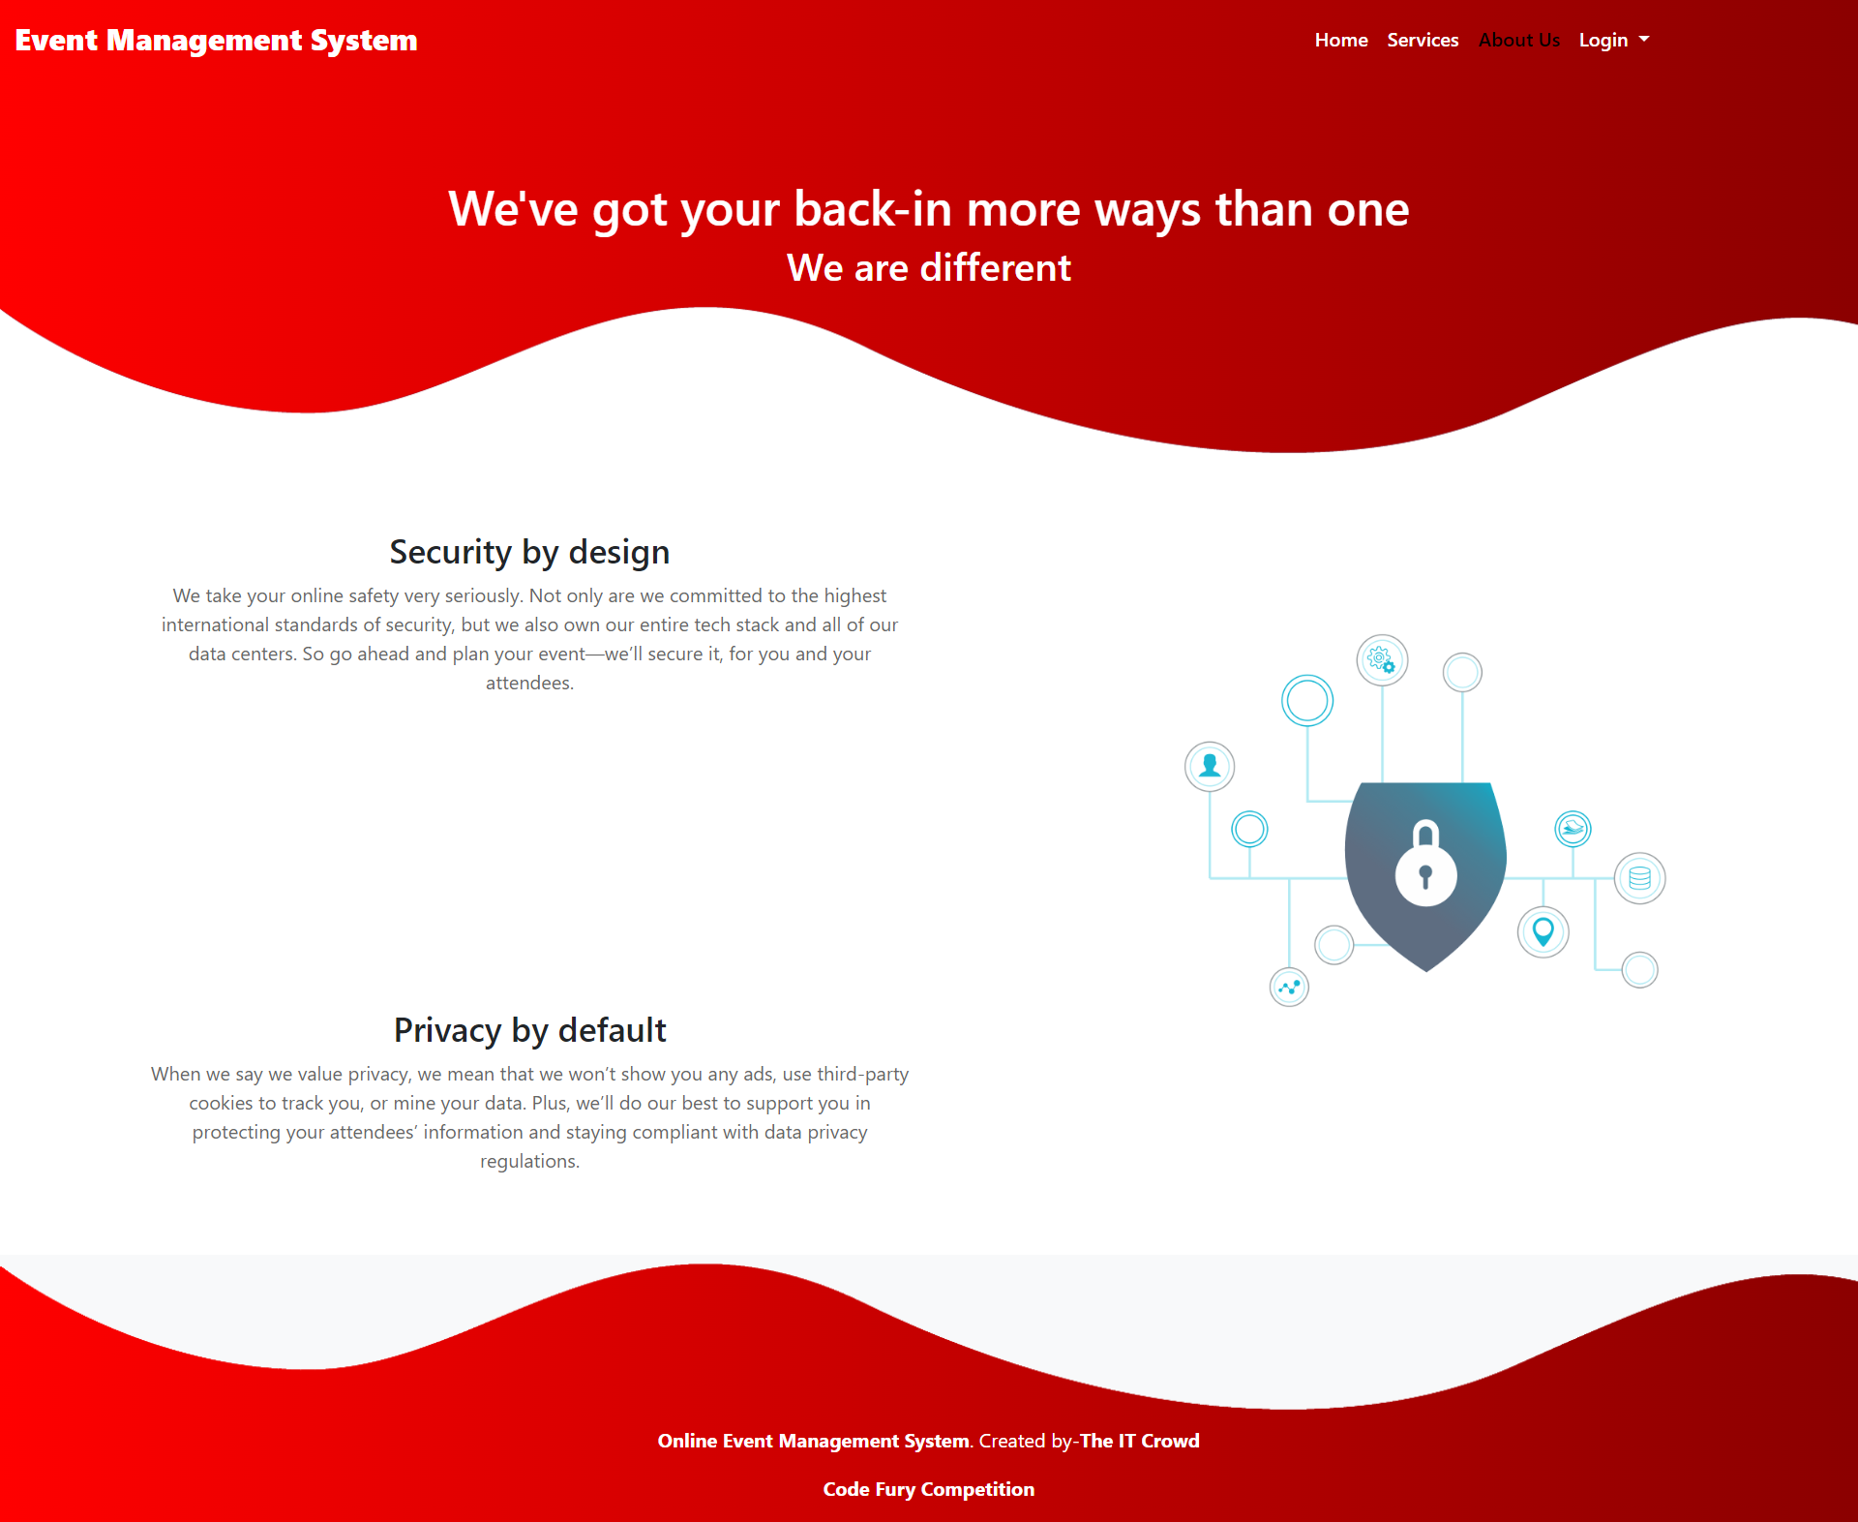
About Us

Slide 7
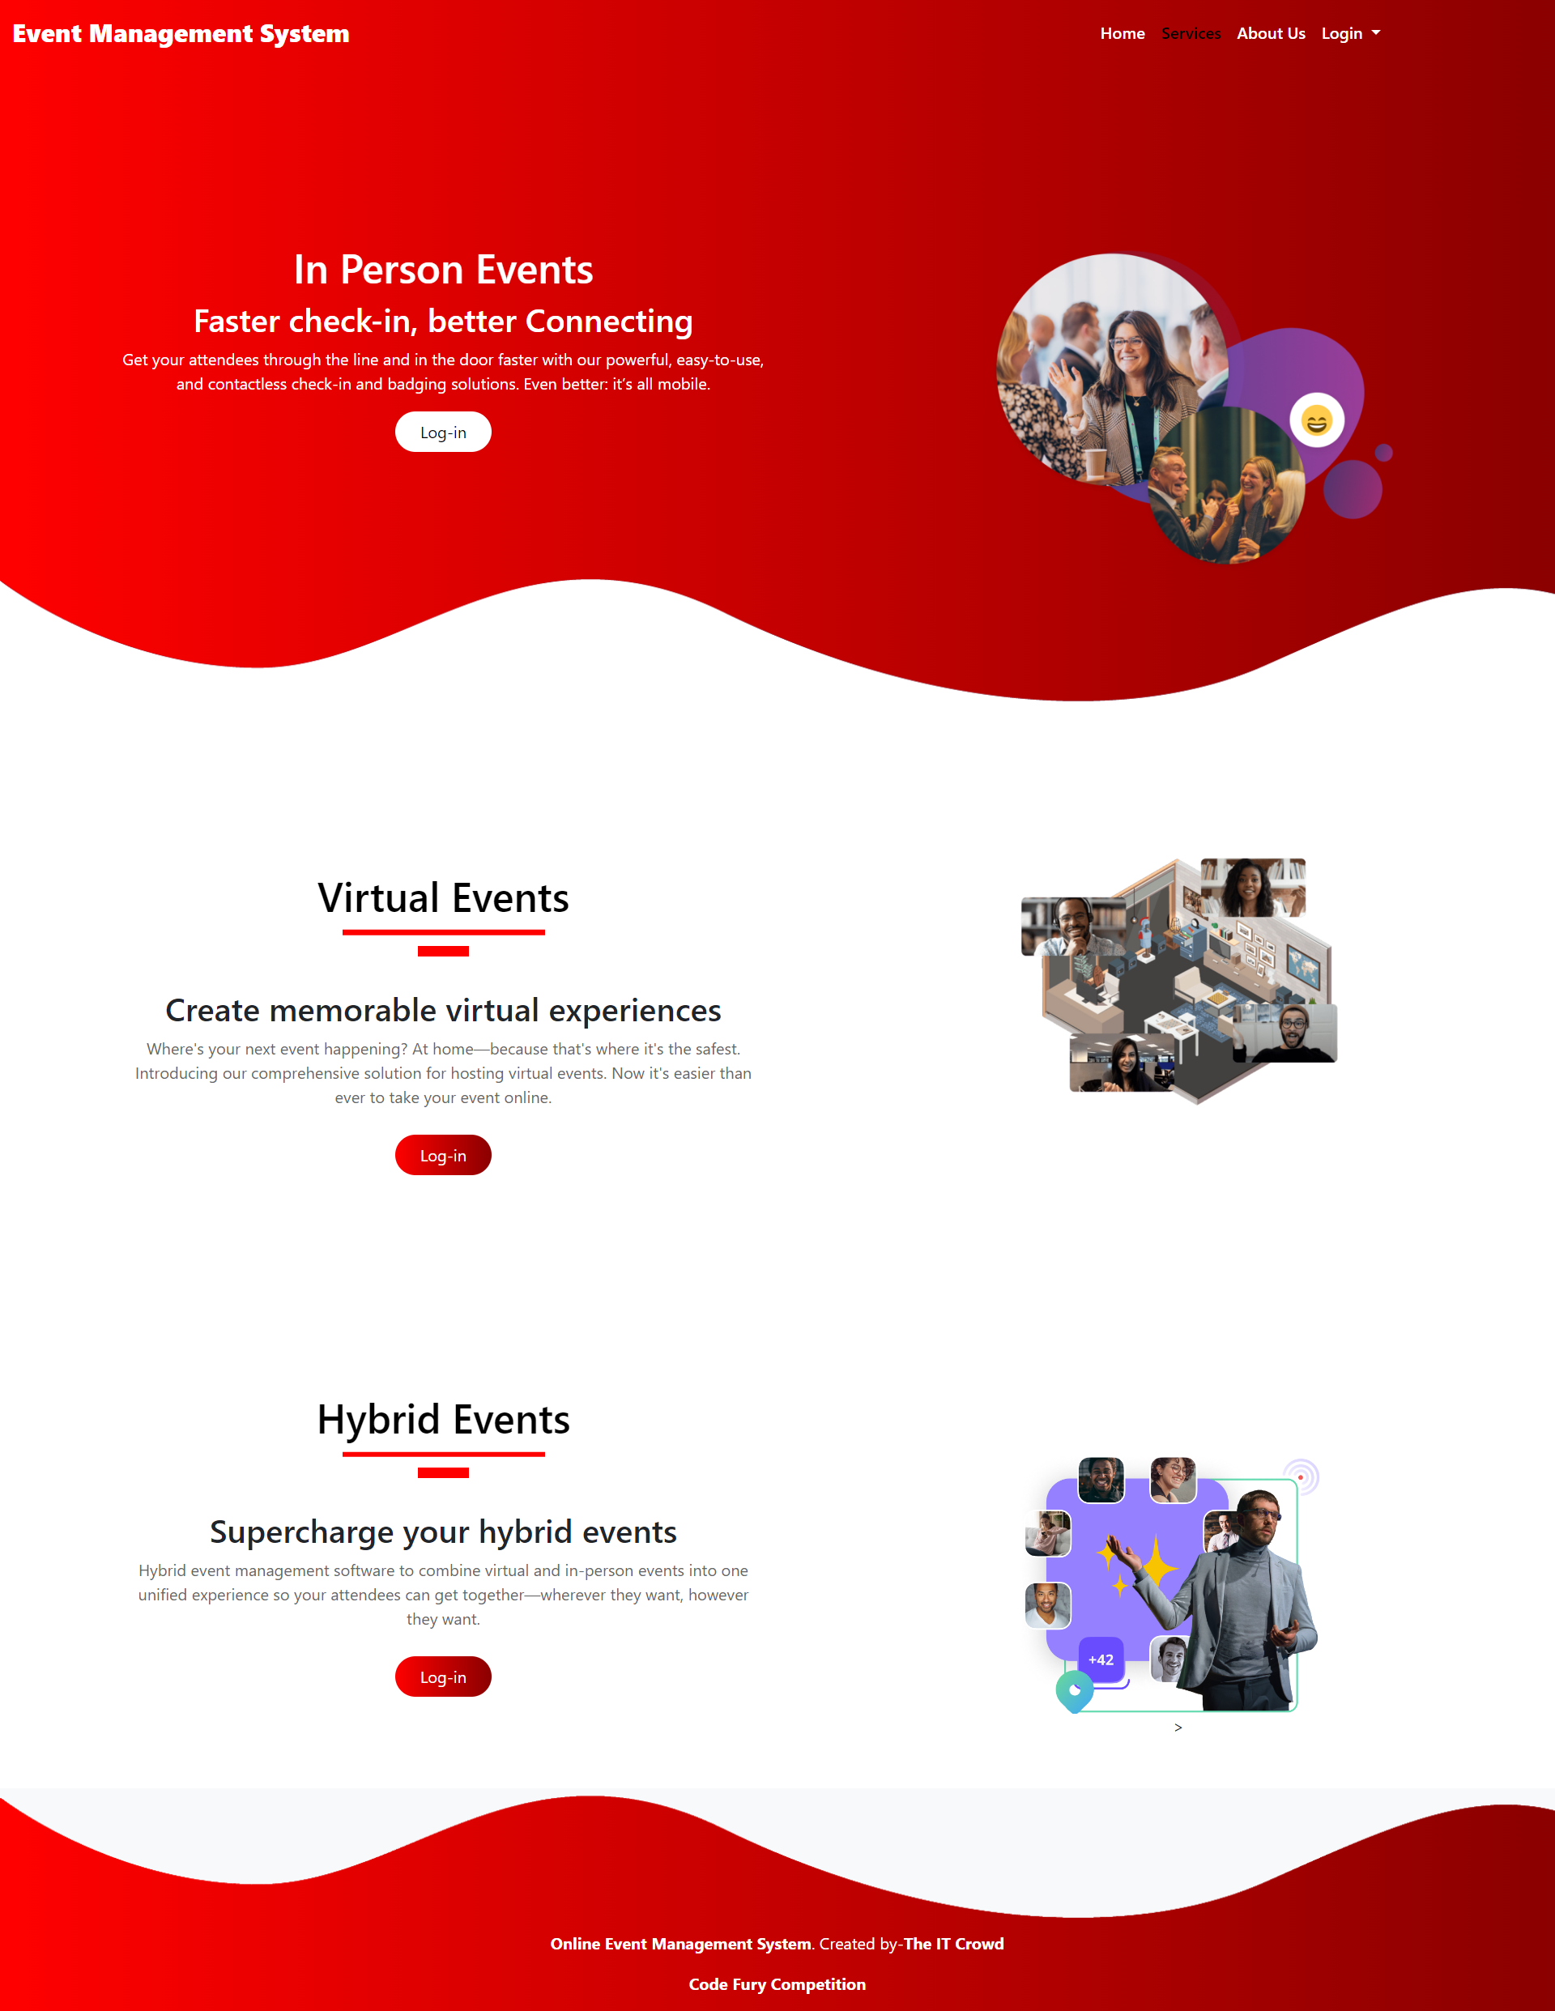
Services

Slide 8
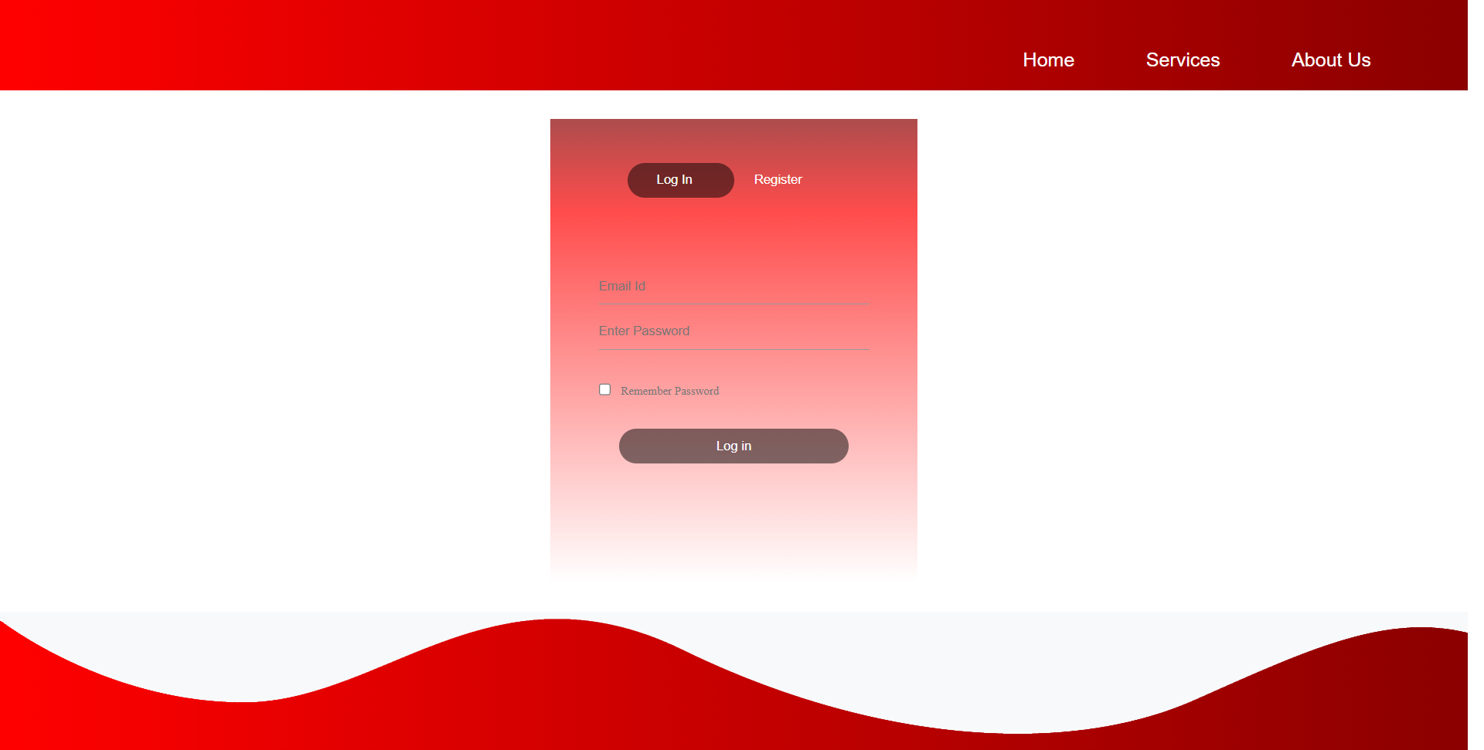
User Login

Slide 9
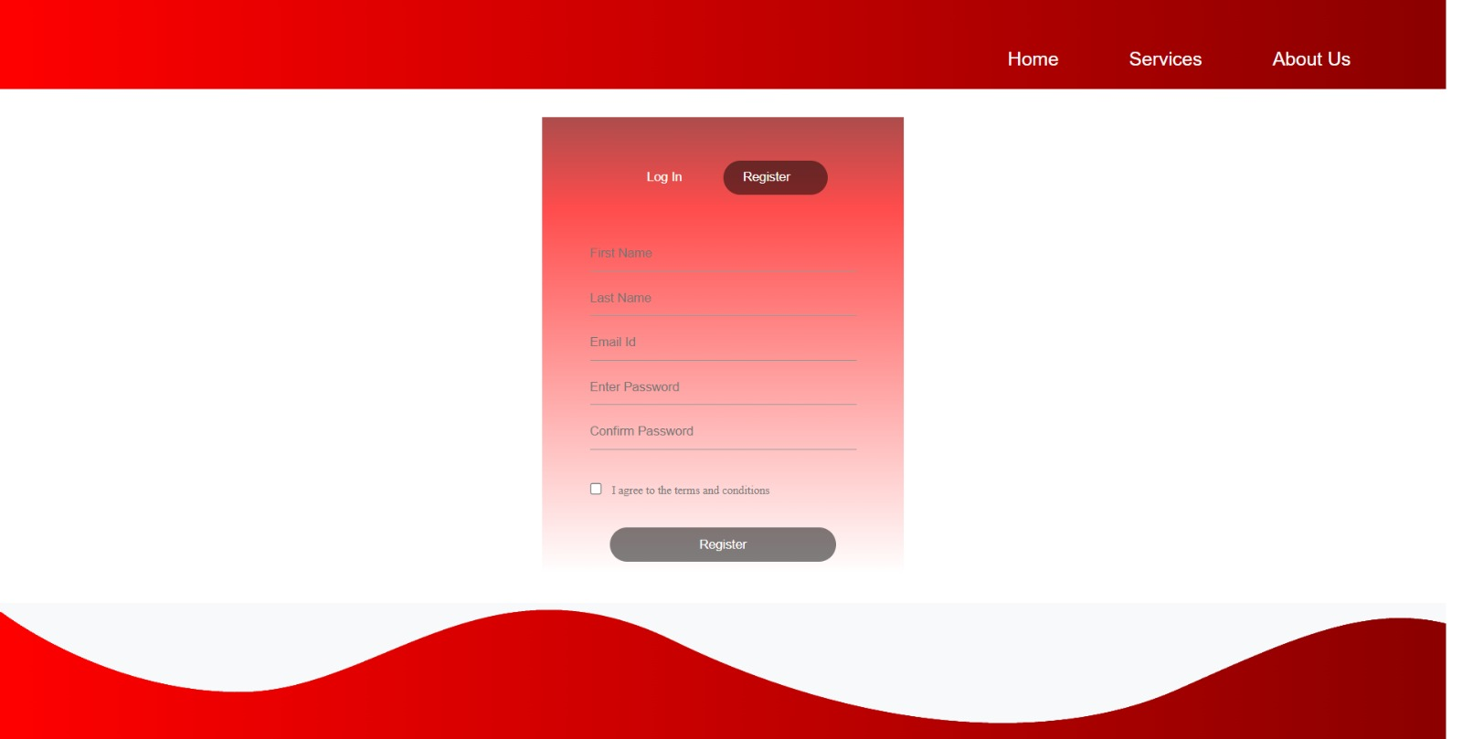
User Registration

Slide 10
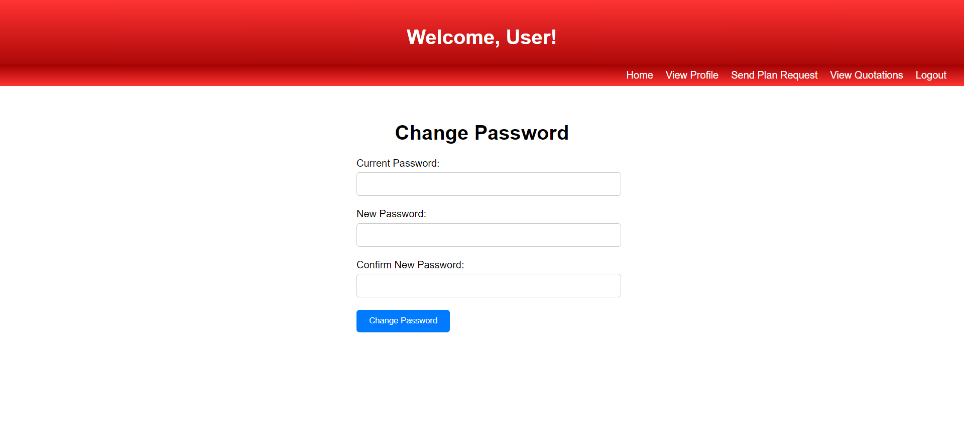
User Change Password

Slide 11
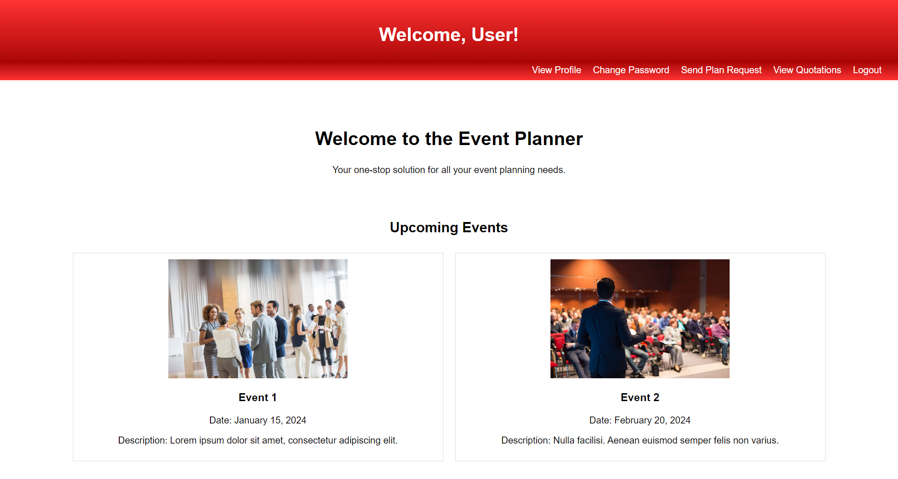
User Home

Slide 12
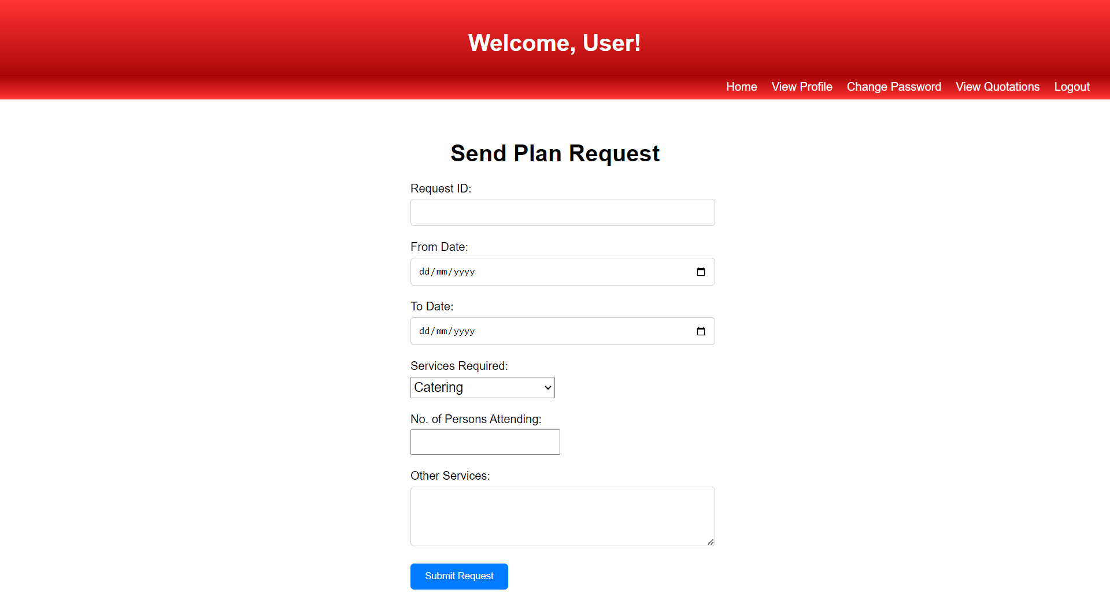
User Send Plan Request

Slide 13
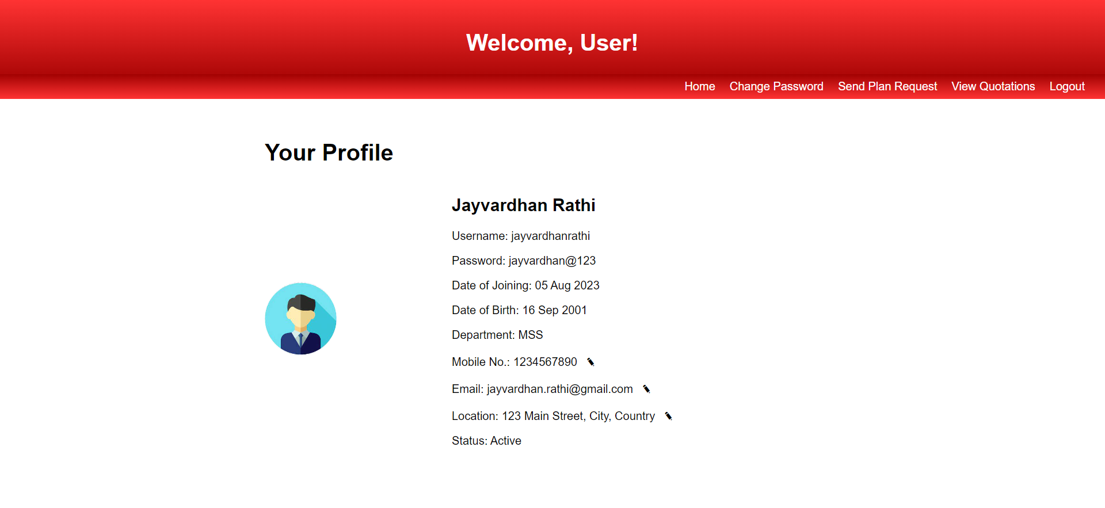
User View Profile

Slide 14
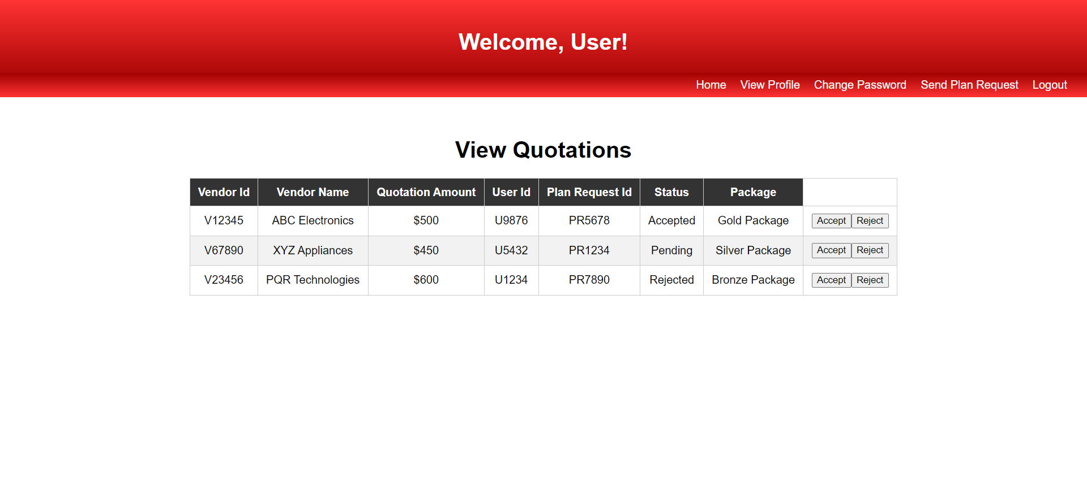
User View Quotation

Slide 15
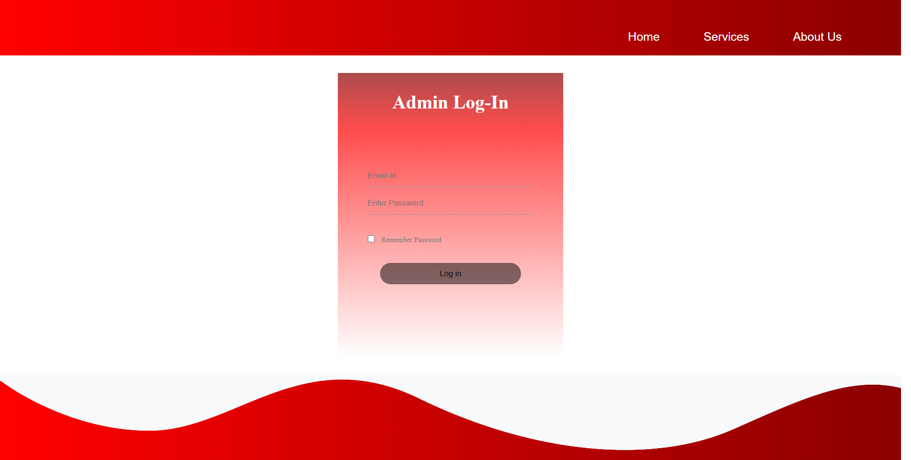
Admin Login

Slide 16
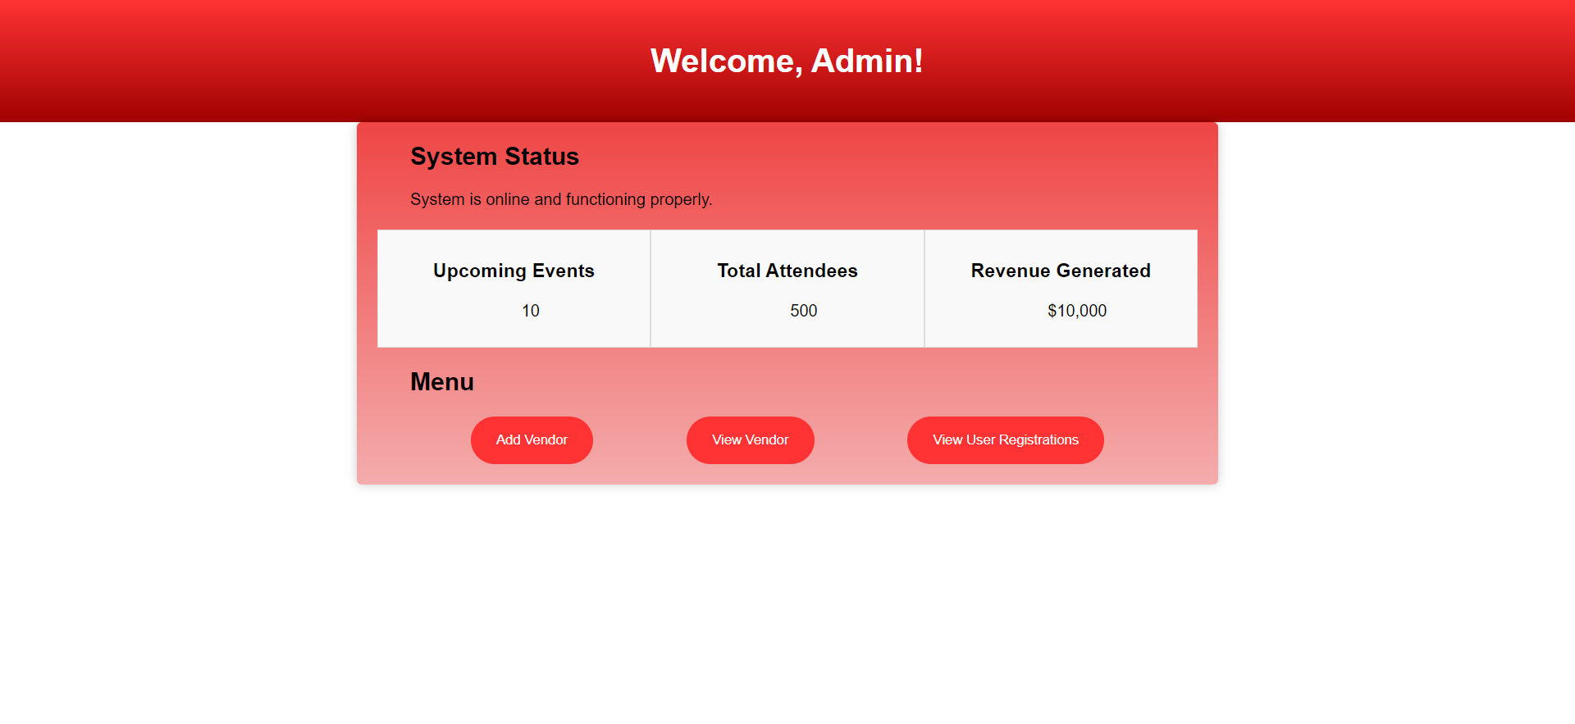
Admin Home

Slide 17
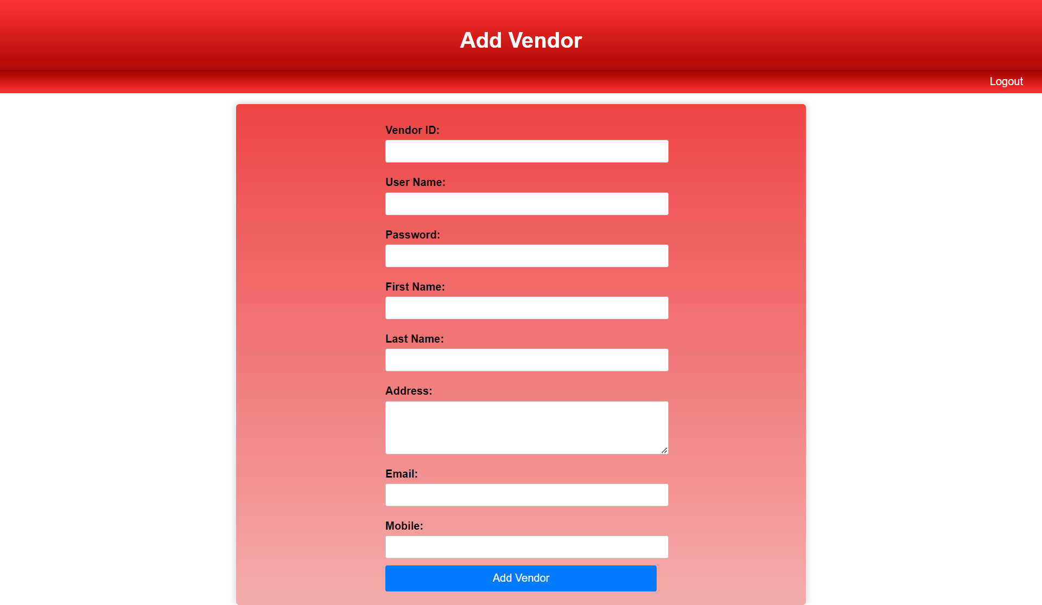
Admin- Add Vendor

Slide 18
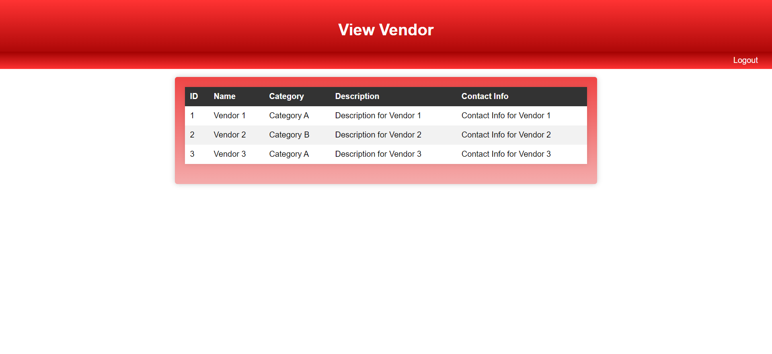
Admin-View Vendors

Slide 19
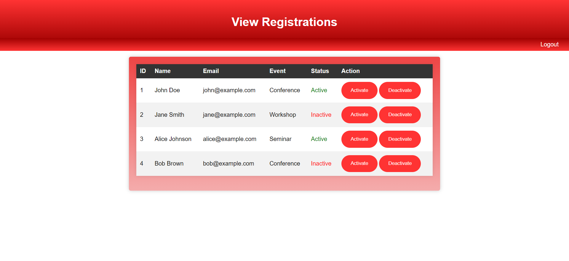
Admin – View Registrations

Slide 20

Vendor Login

Slide 21
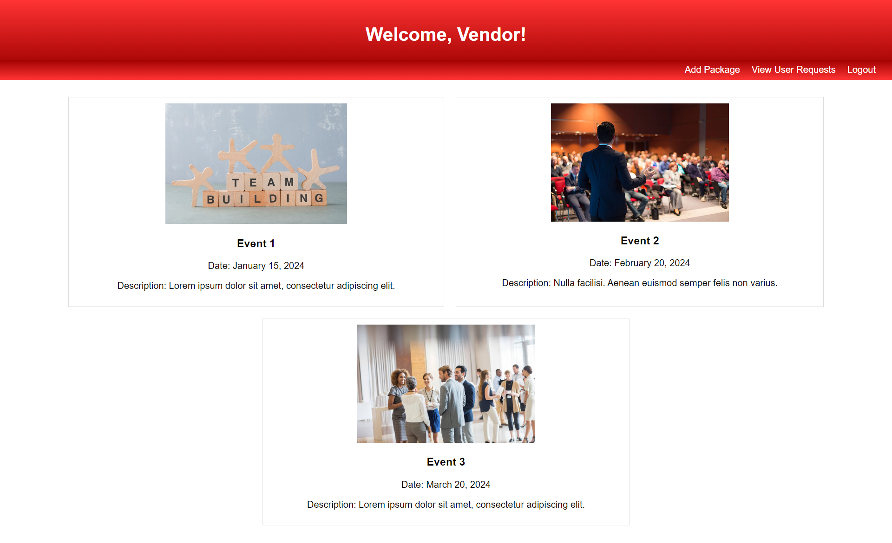
Vendor Home

Slide 22
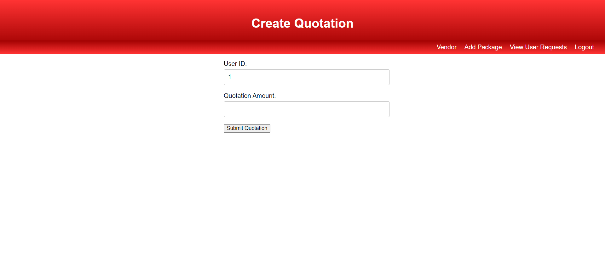
Vendor- Create Quotation

Slide 23
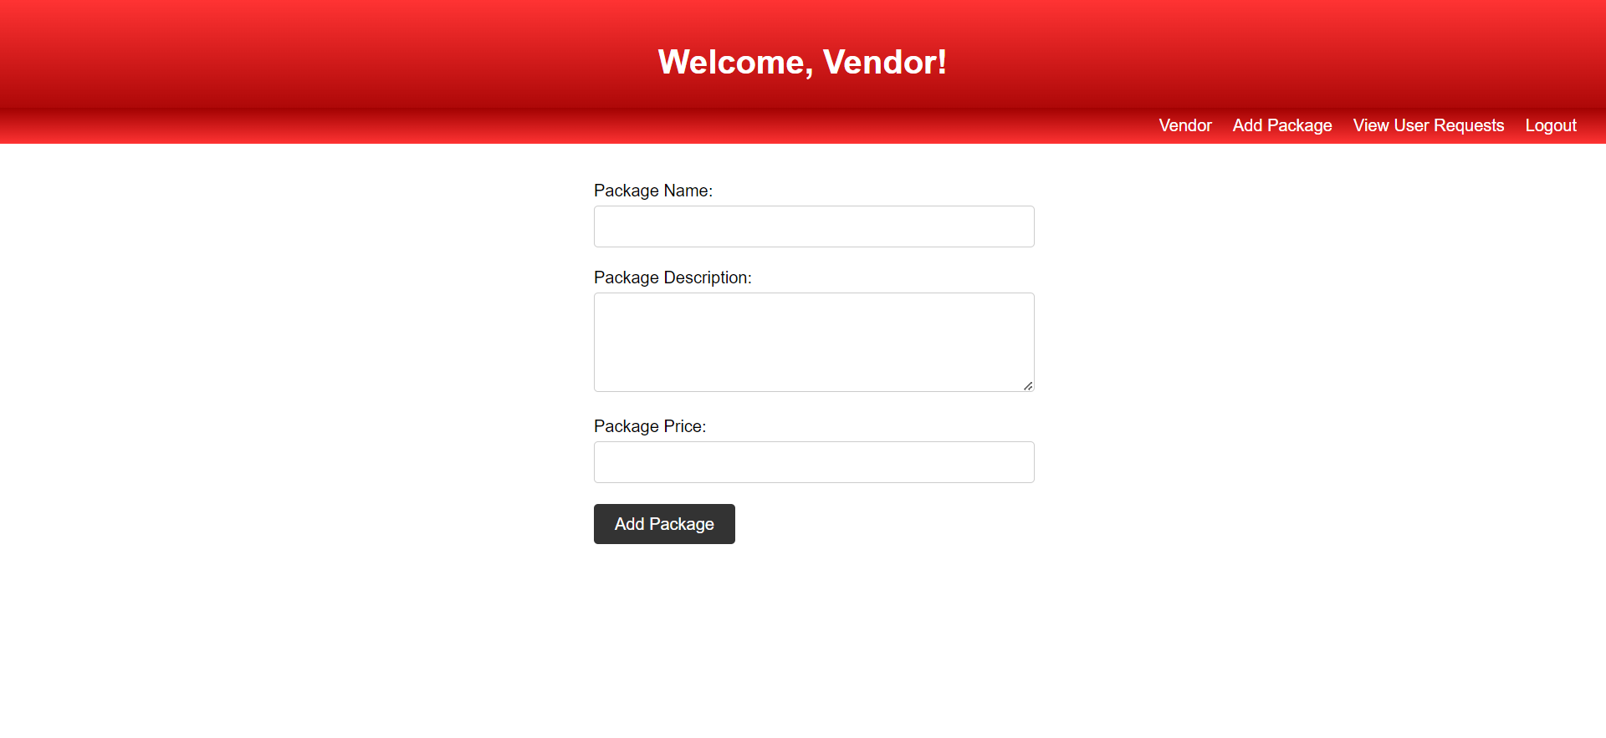
Vendor- Add Packages

Slide 24
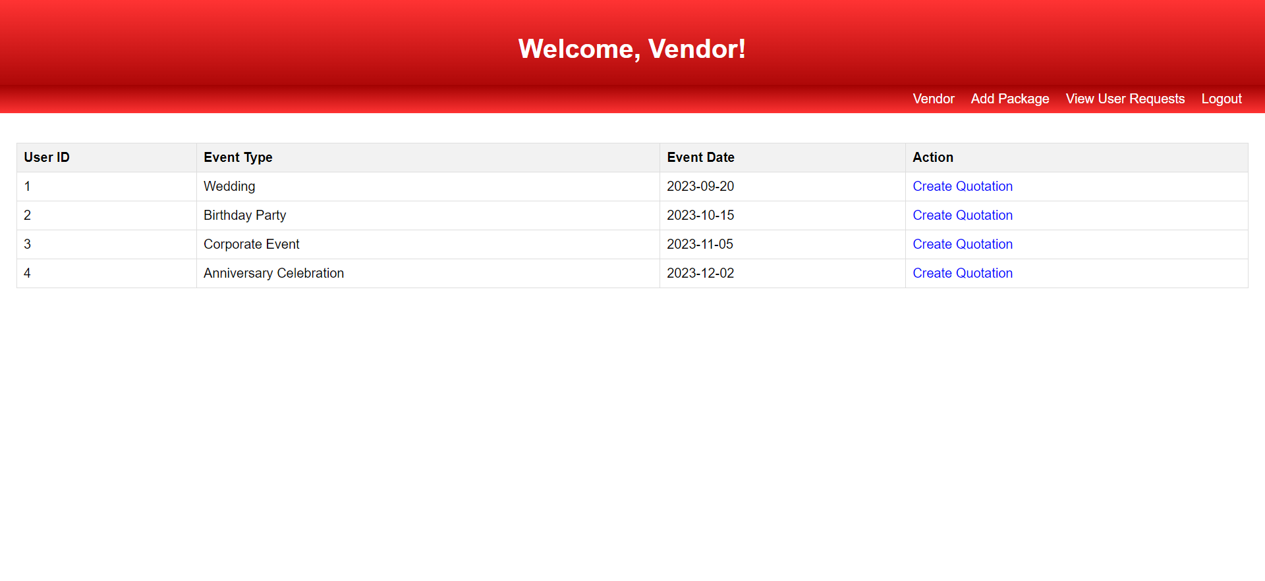
Vendor- View User Requests

Slide 25
Our Learning Strategy
1
Defining Project Goals and Objectives
Evaluating the existing skills of your team members in both front-end and back-end development.
2
3
Choose the appropriate front-end and back-end technologies based on project requirements.
Create a structured learning plan for each team member based on their skill
4
5
Continuously assess the progress of each team member.

